Slide 1
Research Communication Skills
Writing Related Work Section

Slide 2
Intended Learning Outcomes
By the end of this lesson you will be able to:
  explain the importance of a related work section
  describe different ways to write the related work section

Slide 3
What is a related work section
a background to a study that puts it into context
a selection and analysis of existing research which is relevant to your topic
a key to convince people of your ideas

Slide 4
Why do we need related work section?
To establish ....
  Need for work
    Why previous works don’t get it done ...
    The limitations of past work ...
  Mastery over area
    You demonstrate the ability to understand and critically analyze the background research
    ... and to select and source the information that is necessary to develop a context for your work.
  Relationship to other scientific areas
    It shows how your work relates to previous research
  Others?

Slide 5
Finding papers for the related work section / literature survey

Slide 6
You will need to find papers that will help you answer the following questions:
What research has already been done on my topic?
What are the relevant subareas of my topic?
What are the key papers on my topic?
What are the key issues, types of research questions and common approaches?
Other:
  What other research (perhaps not directly on the topic) or other research communities might be relevant?
  Which research community is relevant for my topic?
  What are the relevant places for publication (top conferences and journals) in this community?
  Who are the important authors?

Slide 7
Where to start
Recent paper from top conference
Survey paper, if one exists
Seminal paper, if it is different from the above
And don’t forget to read related work sections of above papers

Slide 8
Step 1 – papers based on keywords
Use an academic search engine, and some well-chosen keywords, to find 3 to 5 recent papers in the area
Prefer journal articles, then conference papers, skip text books
While you read abstracts and titles, refine your keywords and re-iterate
Run Pass I on each paper, then read their related works sections
  You will find a summary of the recent work in your area
  If you are lucky you find pointers to a recent survey paper

Slide 9
Step 2 – key papers from shared citations
Find shared citations and repeated authors in the bibliography
  These are the key papers and researchers in the area
  Download the key papers and set them aside
Find recent articles that cite the important papers found in this step
  Download and set aside the most relevant papers

Slide 10
Step 3 – papers from top conferences
Go to the websites of the key researchers, and see where they published recently
  Helps to identify current top conferences/journals in that field
Go to the website of these top conferences and browse they recent proceedings
  identify recent high quality related work,
  download the most relevant papers

Slide 11
Step 4
The papers you found constitute the first version of your related works
Run Pass I and II on those papers
If they cite a key paper you did not cite earlier, obtain and read it,
Iterate as necessary

Slide 12
Writing the related work section

Slide 13
Do not drown in the amount of information
A literature review is not a straightforward summary of everything you have read on the topic
Neither is it a chronological description of what was discovered in your field

Slide 14
Questions to answer when writing related works section
Am I the first one to have this idea?
Which aspect of my discovery is new and which one is not?
Did someone else have a similar idea?
What are the results and conclusions from other similar ideas?
…

Slide 15
Organize your related work section

Slide 16
Organize your related work section (1)
Start out broad and then become more specific
  First briefly explain the broad issues related to your work. You don't need to write much about this, just demonstrate that you are aware of the breadth of your subject
  Then narrow your focus to deal with the papers that overlap with your research
  Finally, concentrate on the research which is closely related to your specific work. Proportionally you spend most time discussing those papers

Slide 17
Example

Slide 18
LASEC: A Localized Approach to Service Composition in Pervasive Computing Environments
This paper proposes a localized approach to service composition in pervasive computing environments
The related work section is organized from broadly related to most related

Slide 19
LASEC: A Localized Approach to Service Composition in Pervasive Computing Environments
Service composition in different kinds of environments
Approaches to composition in pervasive computing environments
Motivate the need for localized solutions

Slide 20
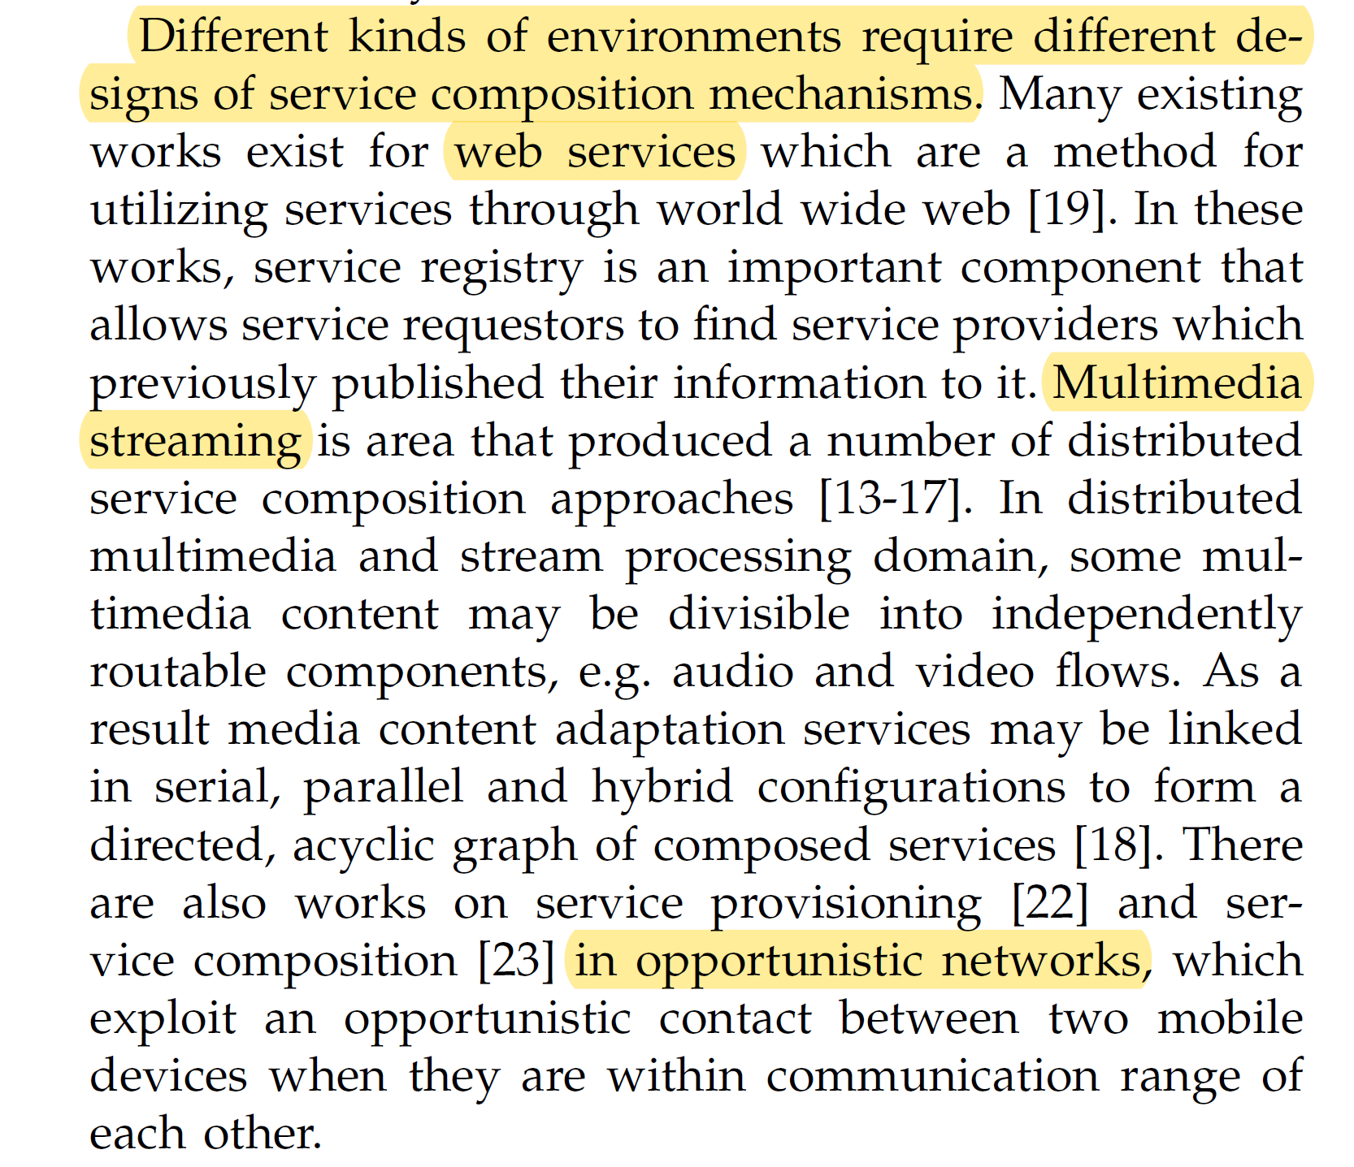

Slide 21
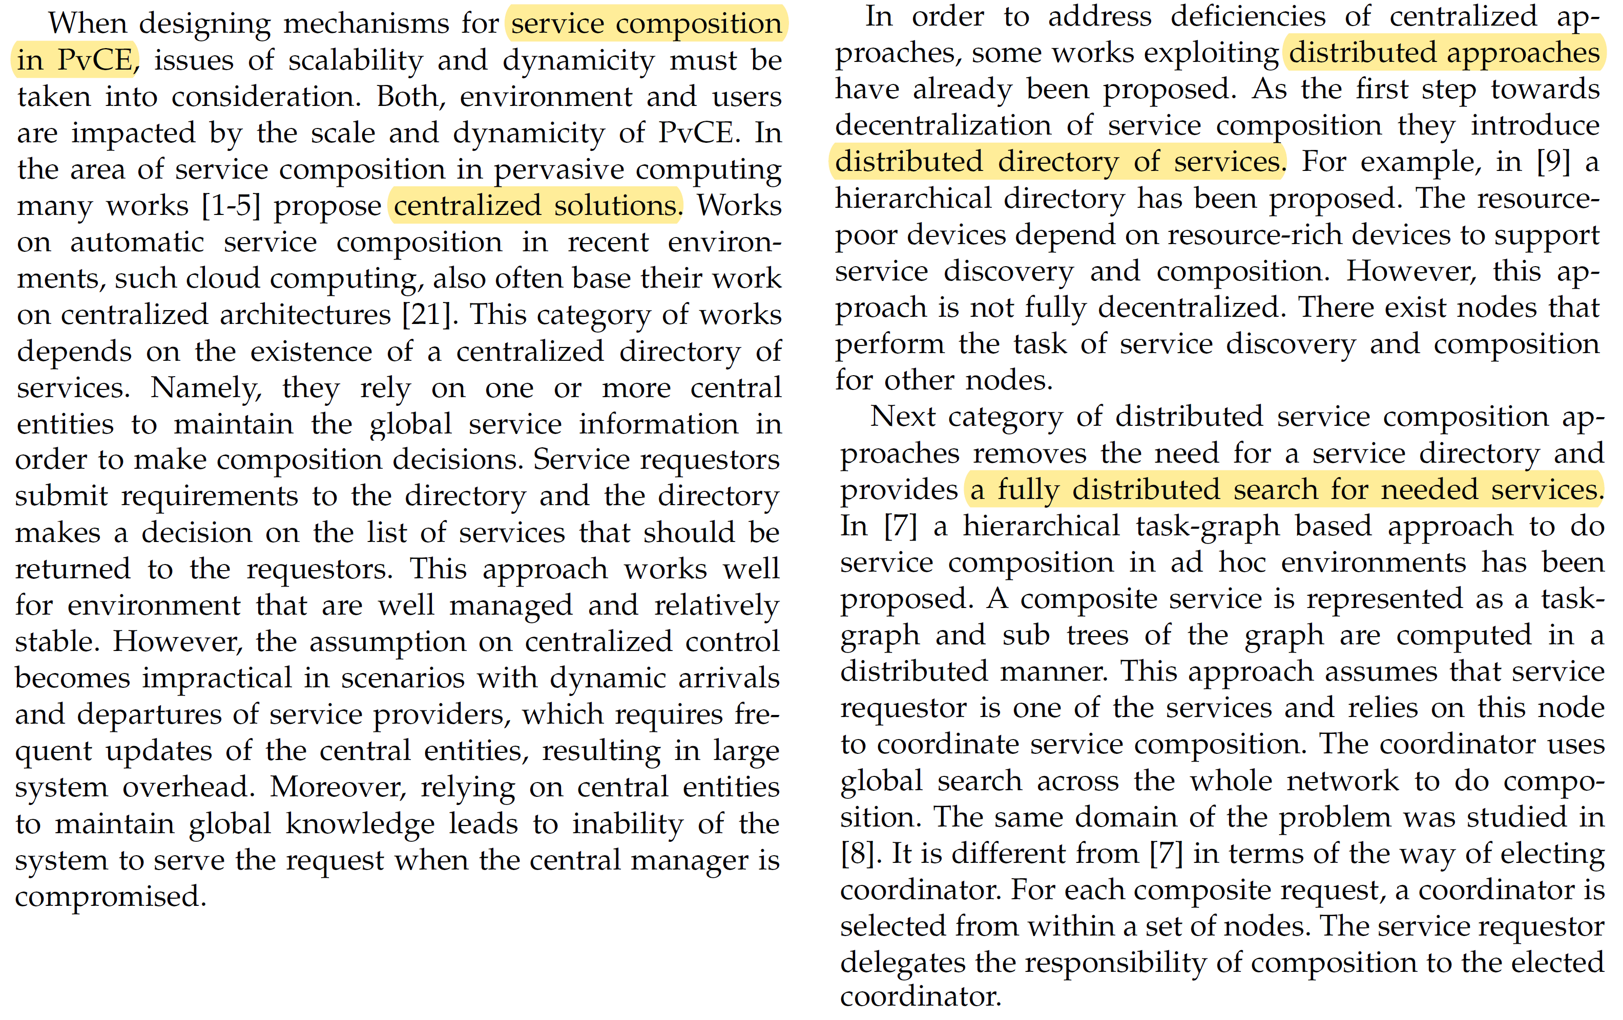

Slide 23
Organize your related work section (2)
To deal with a large body of related work, group similar works together according to e.g. commonly used theories, methods, system properties, etc.
This helps to compare and contrast their approaches and facilitates the discussion with the literature in view of your new idea
Be careful and exact in dismissing related work when promoting your idea

Slide 24
How to write related work section?
Common way
  Algorithms a, b, c, and d. have been done.
    A is good because of …, bad because of ….
    B is good because of …, bad because of ….
    C is good because of …, bad because of ….

Slide 25
How to write related work section?
Better way
  Tell a story about the field in which it exists. It should try to organize the field in such a way as you can see how the work evolves from start to finish.
  Ideally, ends with the conclusion that the present work is needed.

Slide 26
How to write related work section?
Better way (example)
  (paragraph 1) The early algorithms, A and B, sought to solve the requirements X, Y, and, Z by (approach/method). However such approaches eventually lead to (some disadvantage of their solution), to differing degrees.
  (paragraph 2) C, D, and other also tried to solve the same problem, but failed ...
  (paragraph 3) Ultimately, the previous works did not solve the problem, and this paper aims to provide a solution.

Slide 27
How to write related works section
A good related work section should include works …
  If they address the central problem
  If they address a related problem
  If they identified the problem
  If they use the same methodology for a similar problem
  If your work was inspired by them

Slide 28
Summary
Choose the right papers for your related work sections
Organize your related work section properly

